Slide 1

Intel’s next gen半導體工藝
組員：林偉翔01257174、許能翔

Slide 2
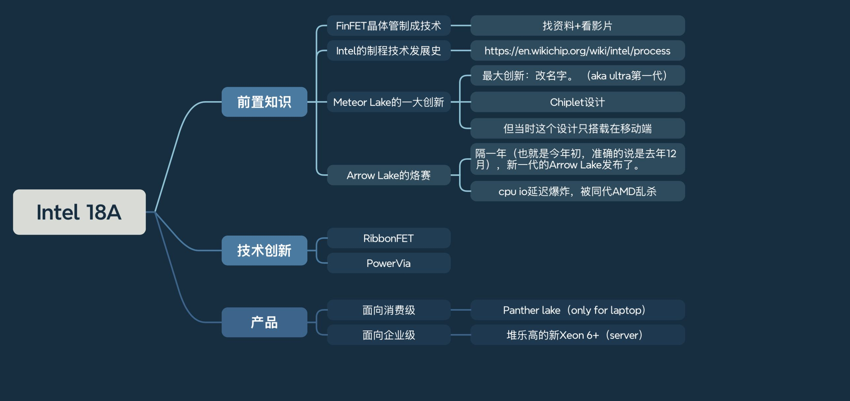

Slide 3
前置

Slide 4
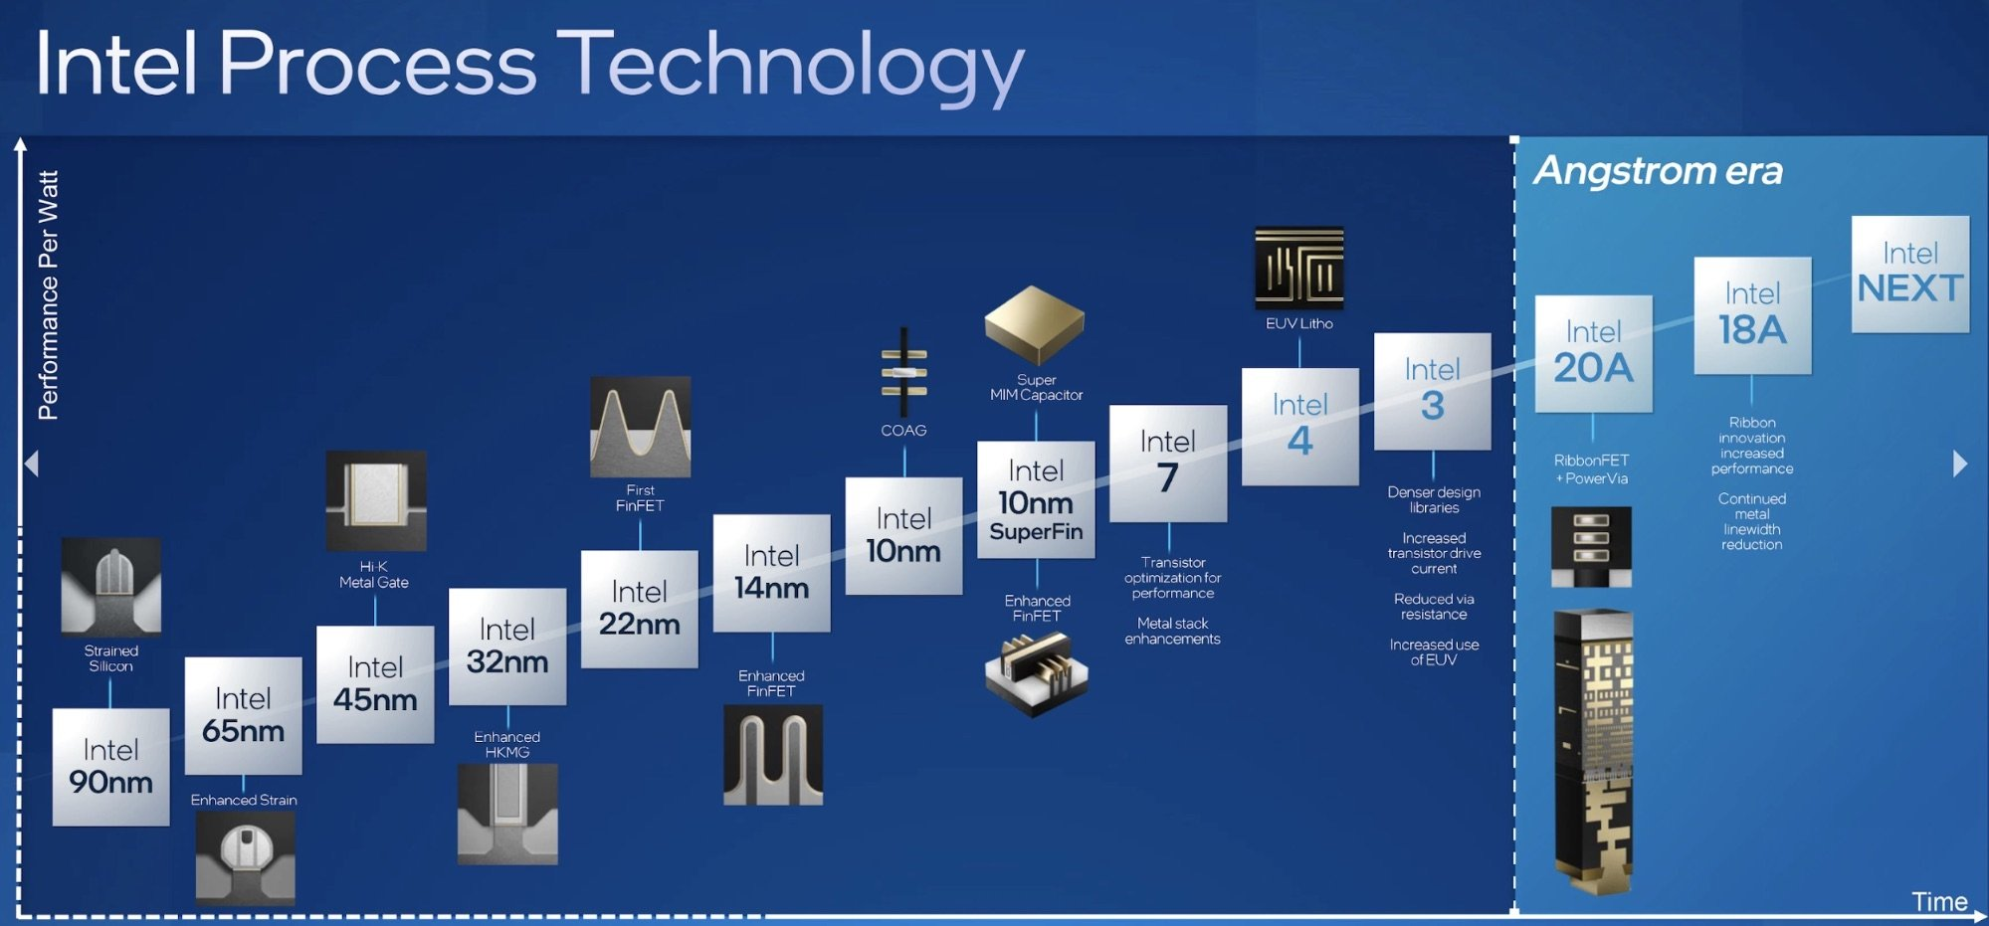

Slide 5
“Meteor lake的革新”

Slide 6
“Arrow lake的烙賽”

Slide 7
“簡單帶過FinFET”

Slide 8
“簡單帶過FinFET”

Slide 9
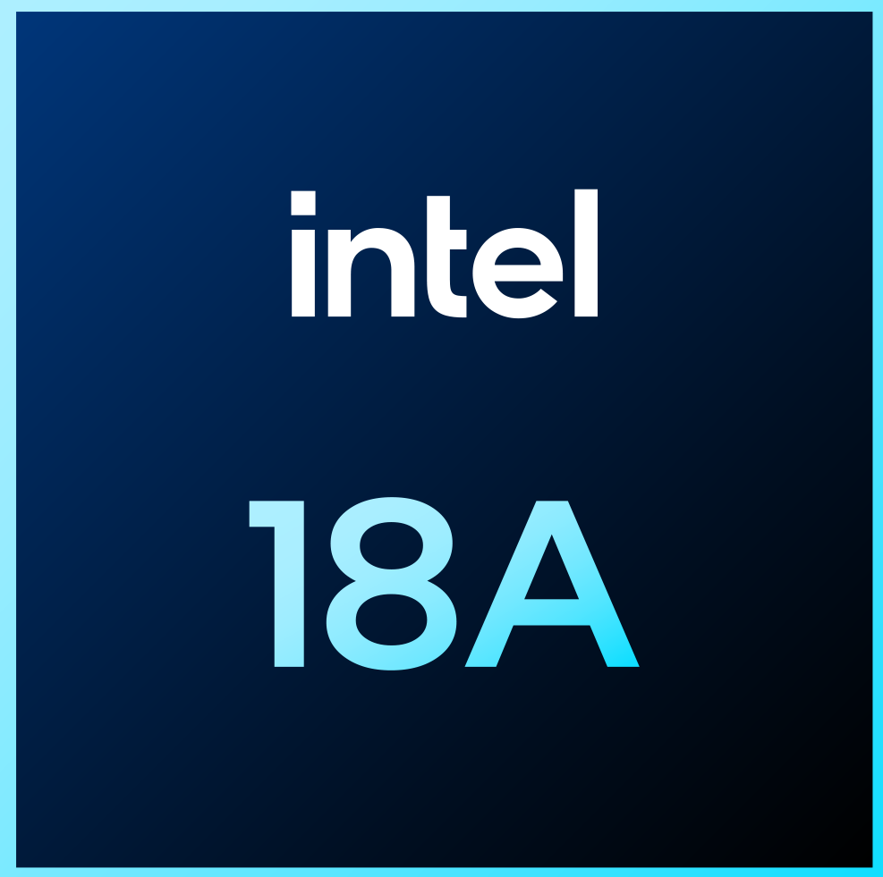

Slide 10
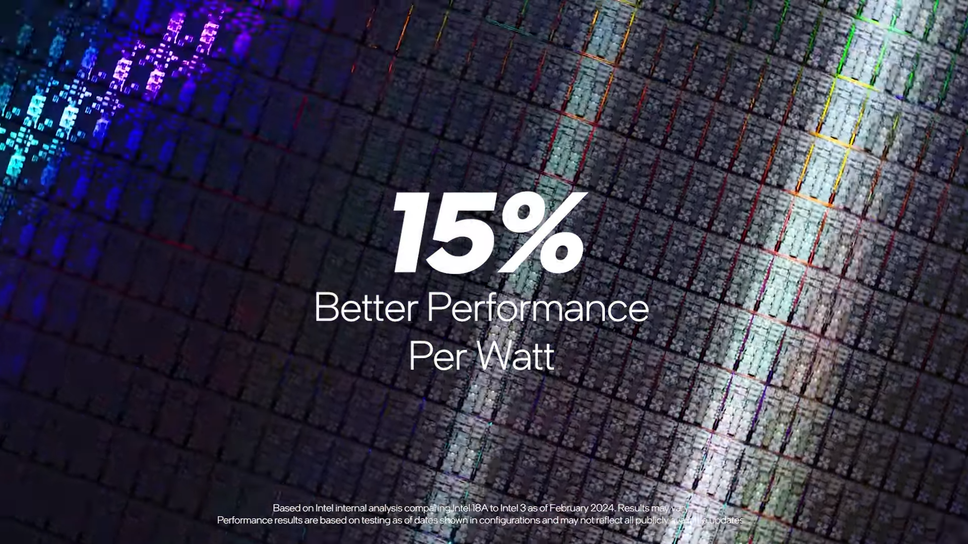

Slide 11
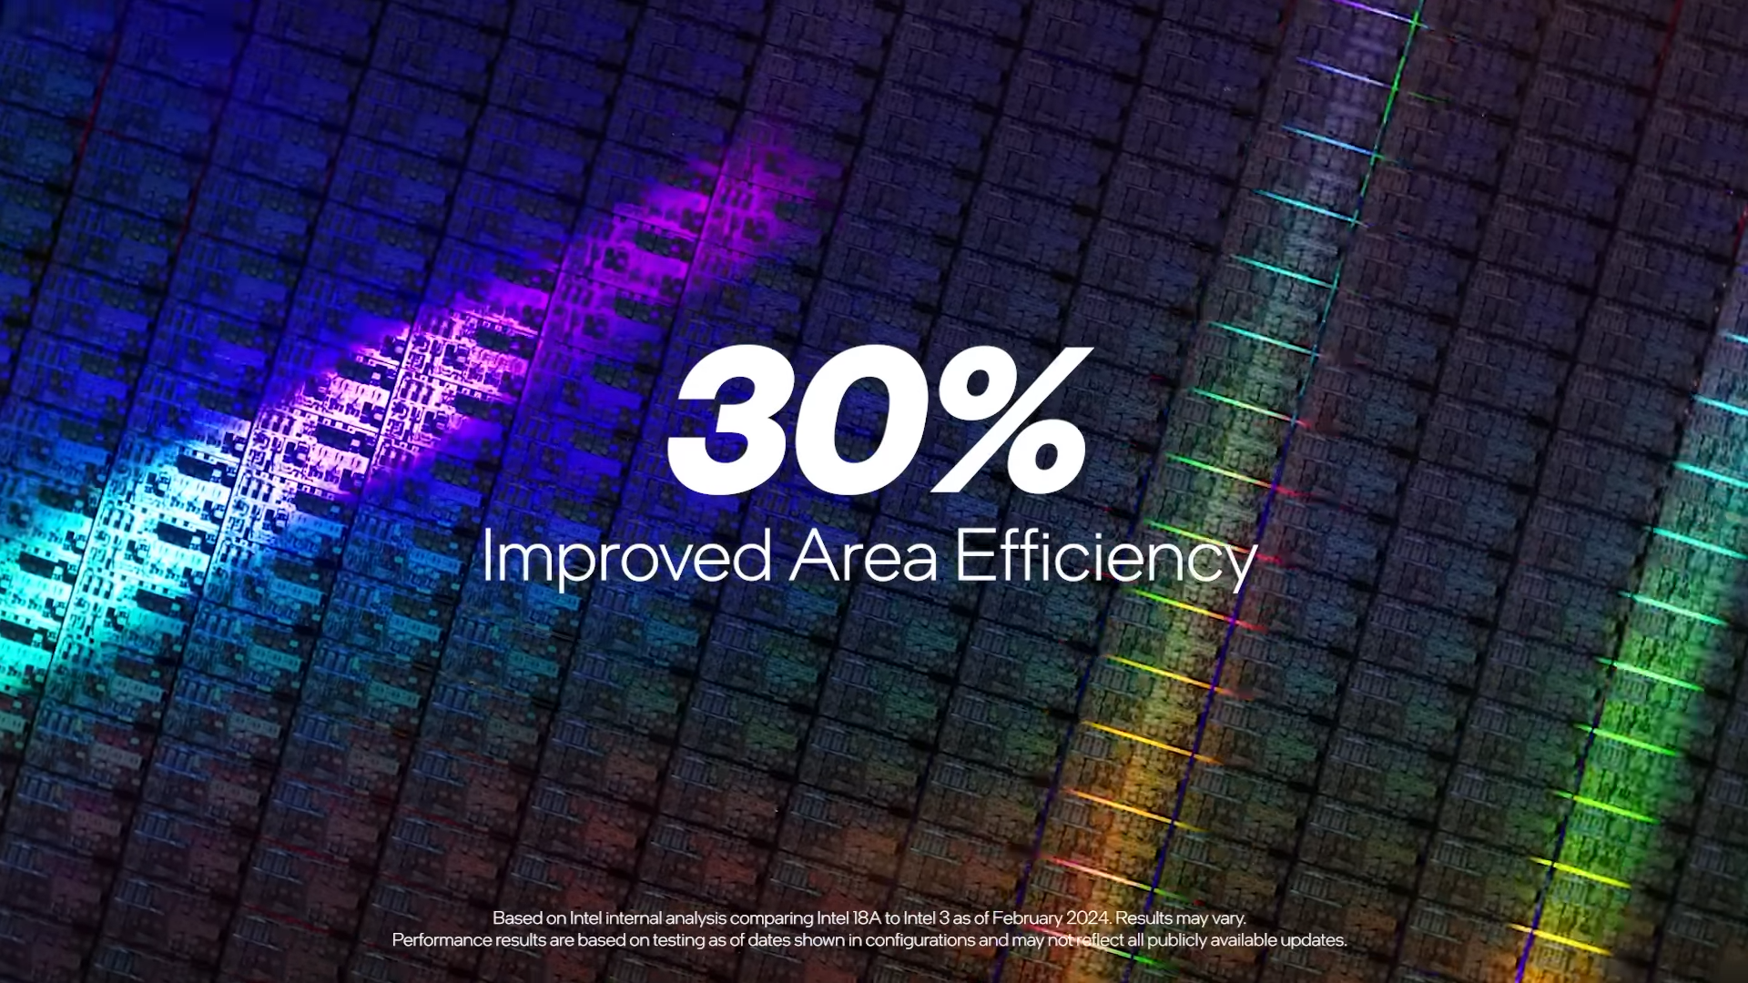

Slide 12
背面供電
PowerVia

Slide 13
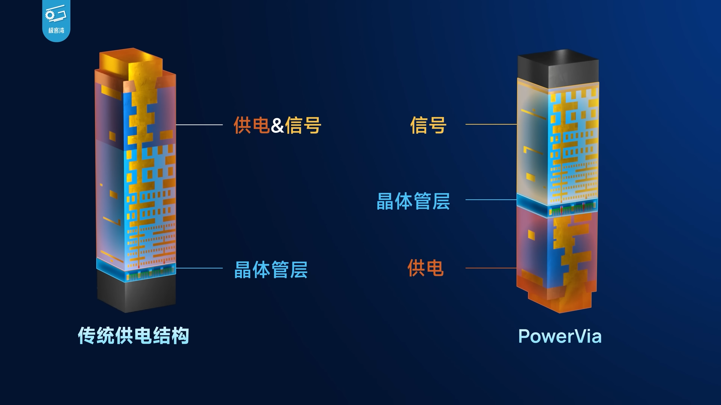

Slide 14
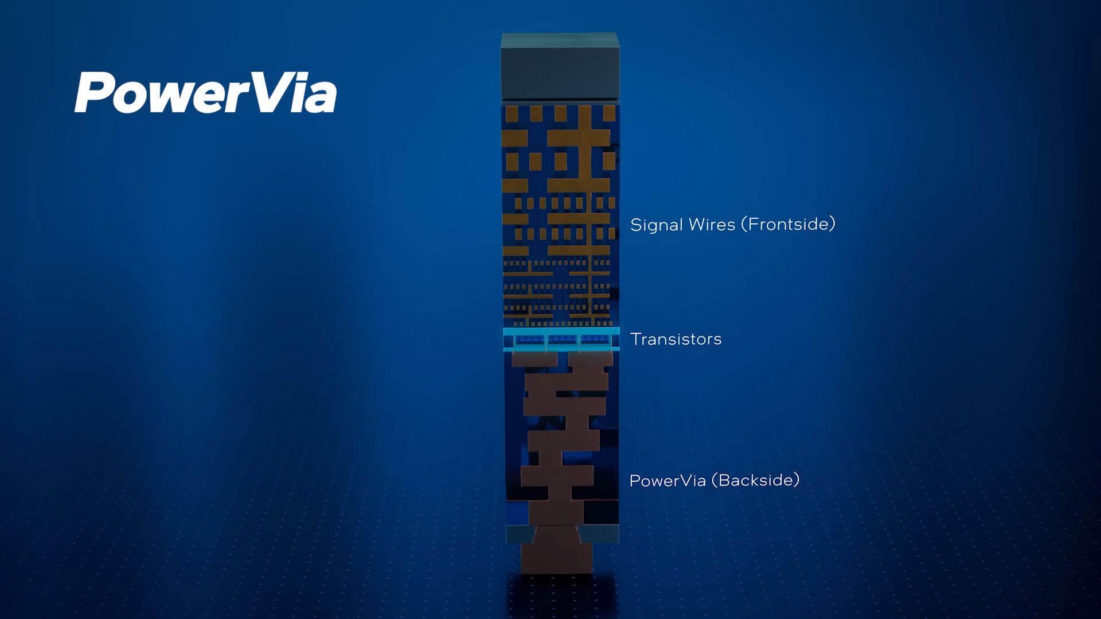

Slide 15
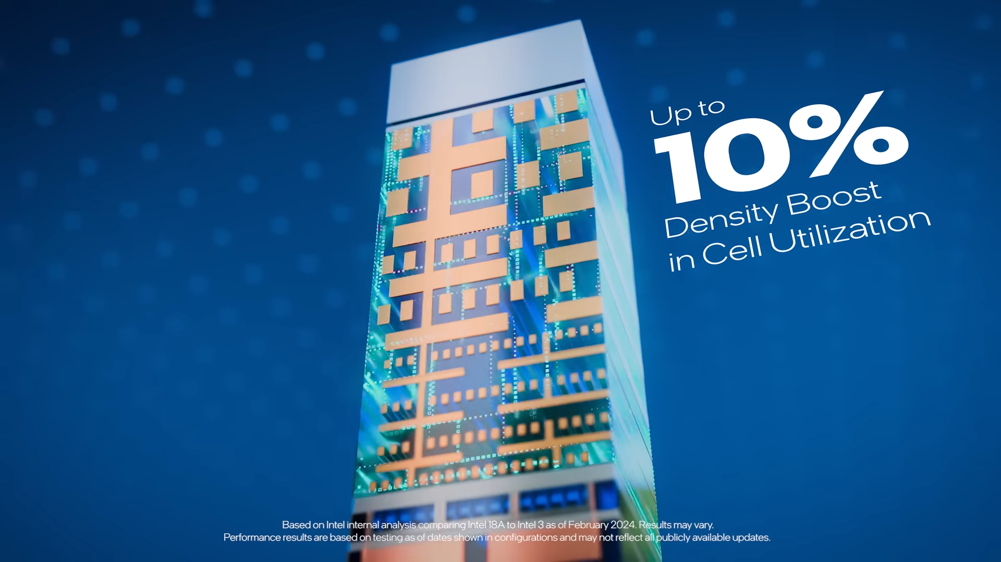

Slide 16
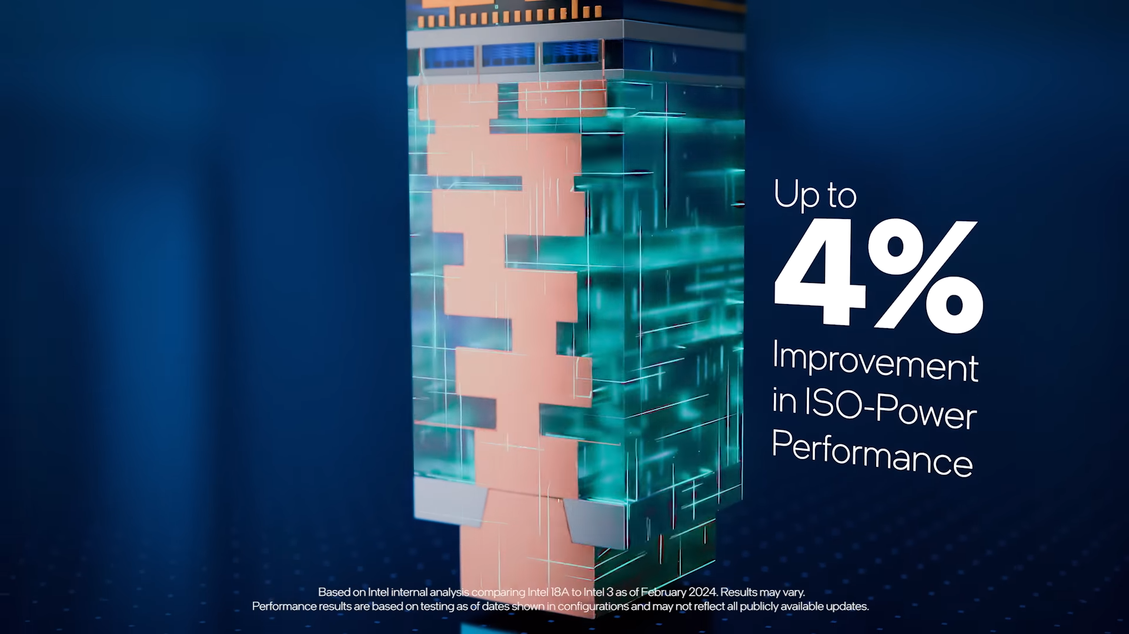

Slide 17
RibbonFET
aka GAA

Slide 18
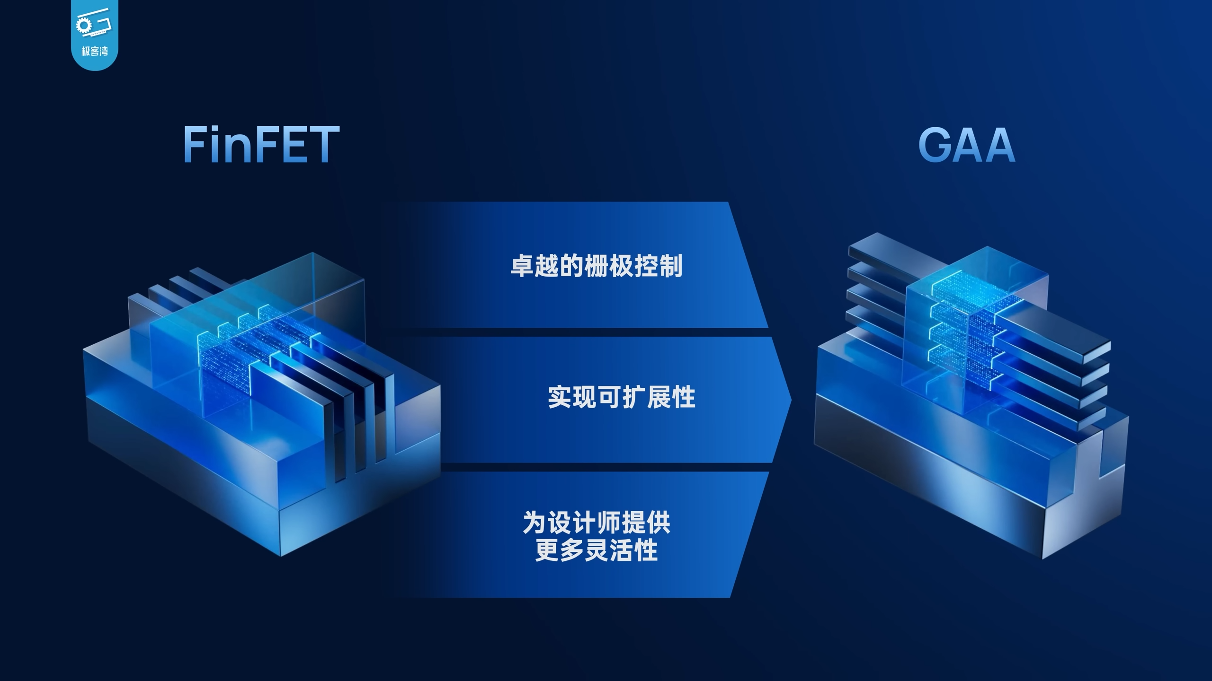

Slide 19
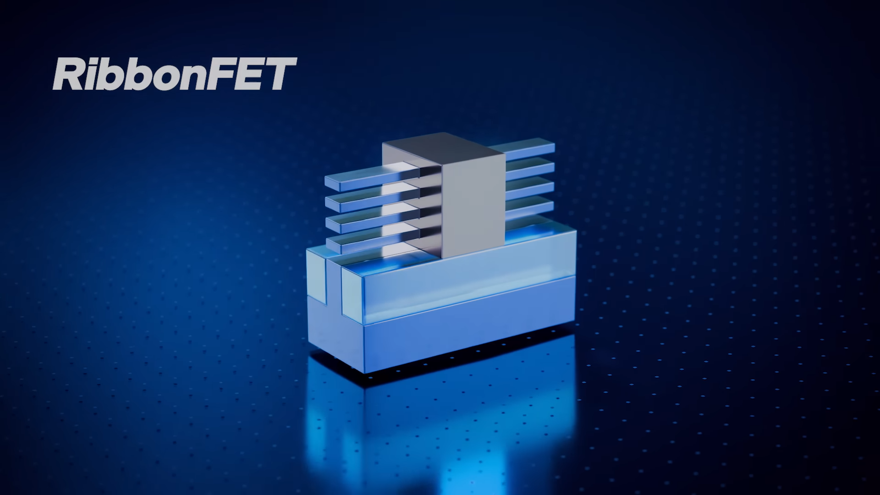

Slide 20
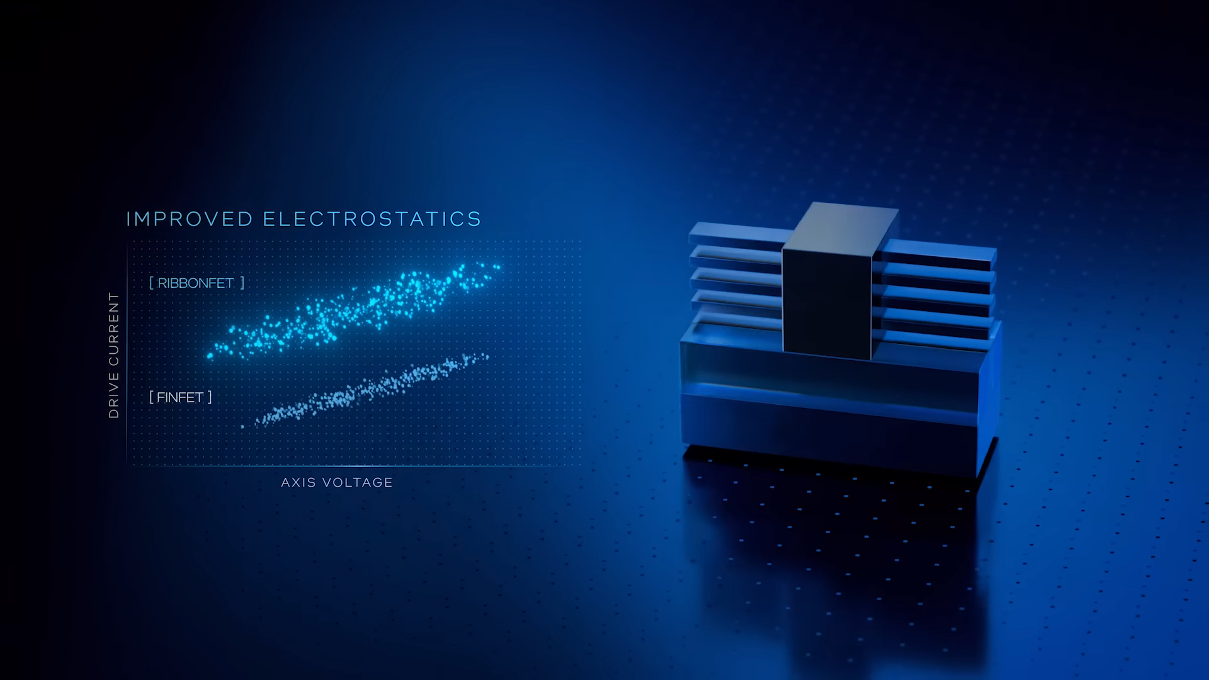

Slide 21
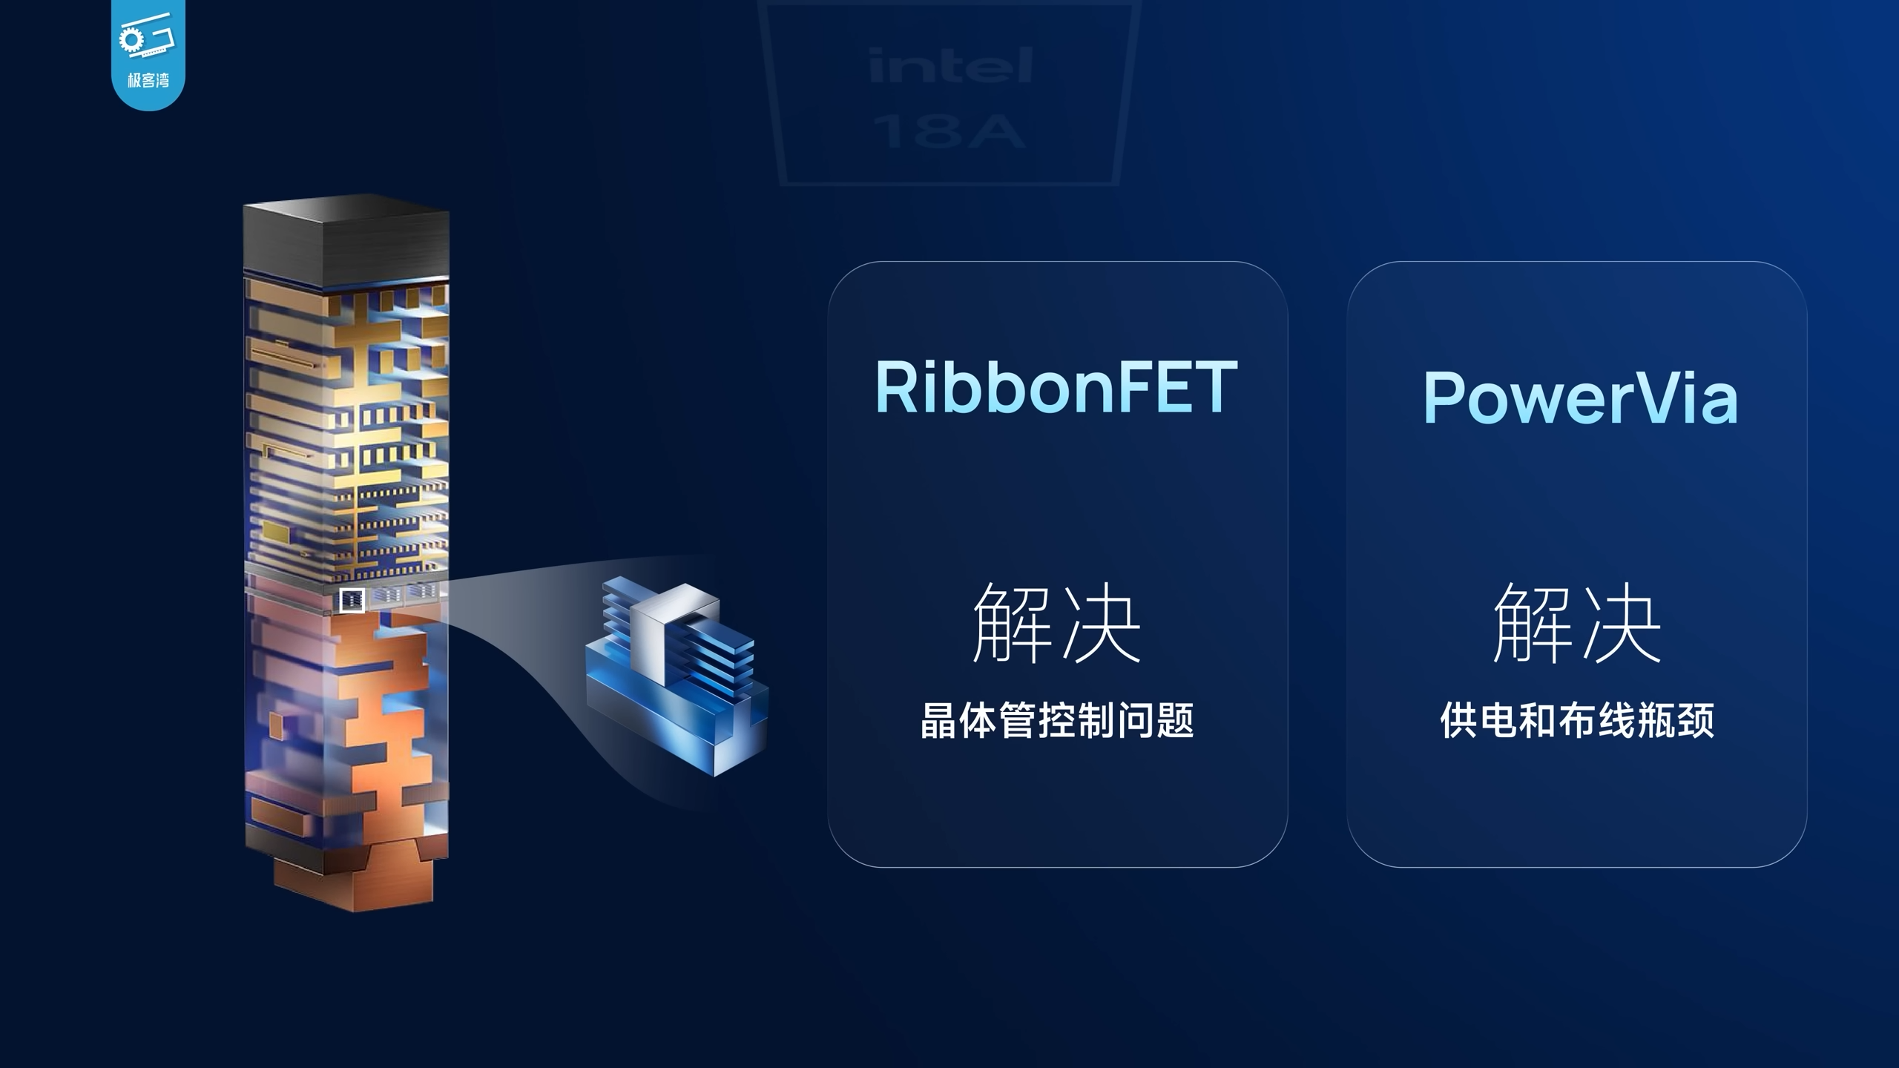

Slide 22
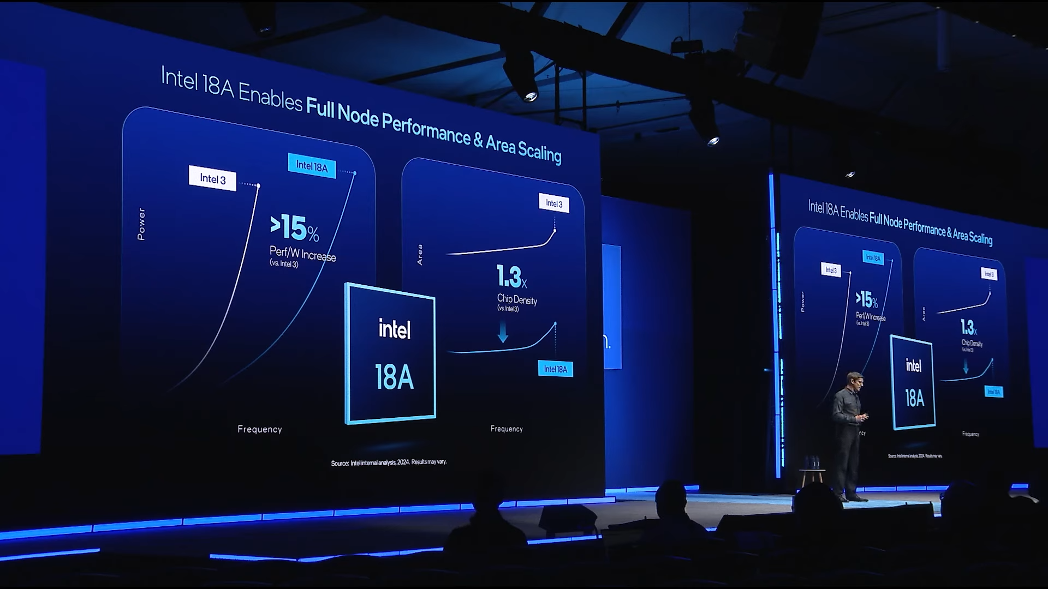

Slide 23
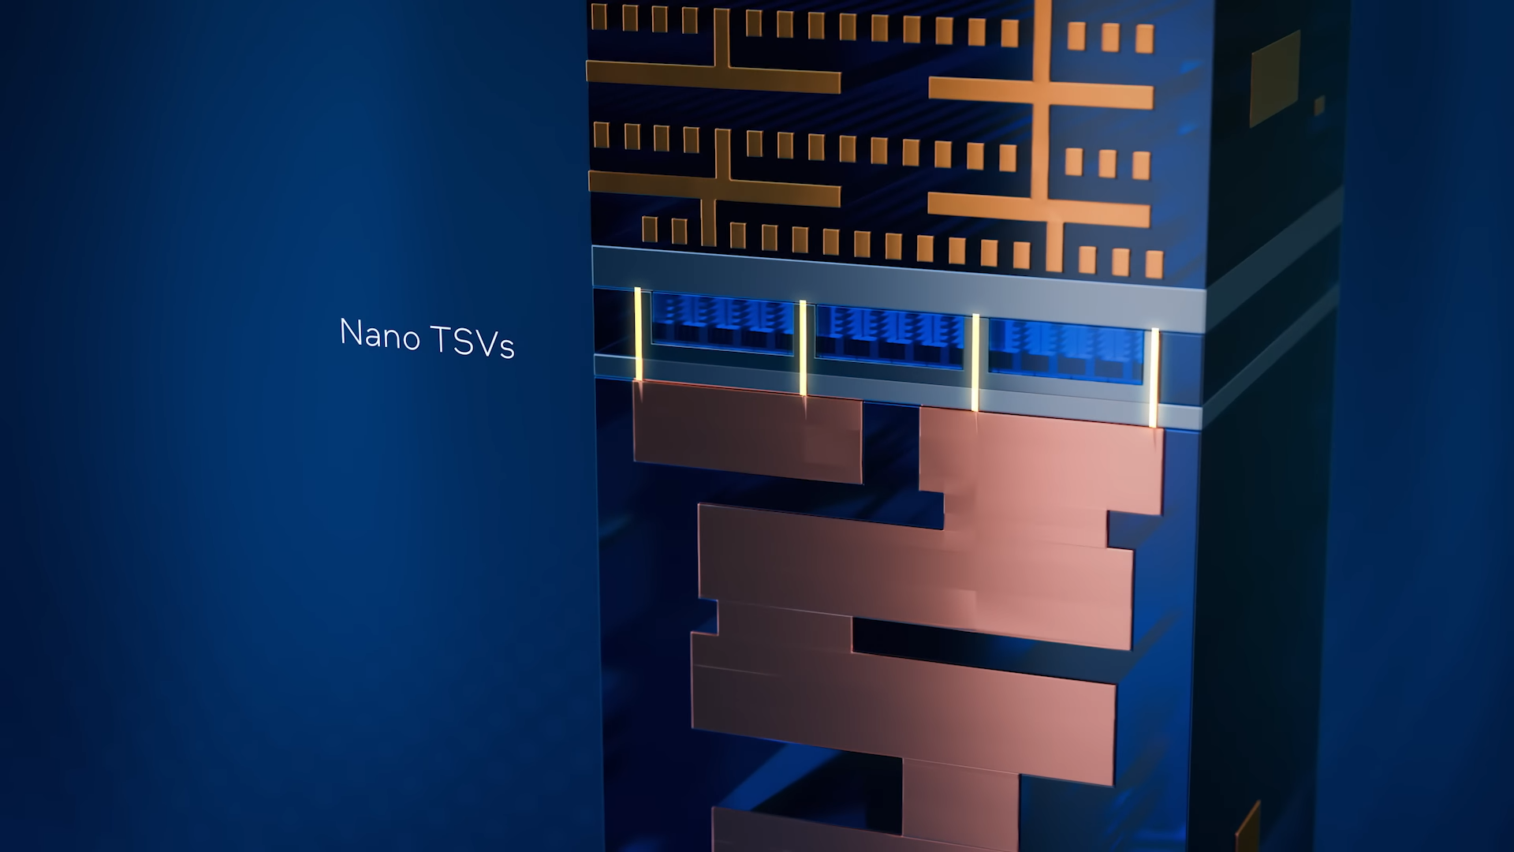

Slide 24
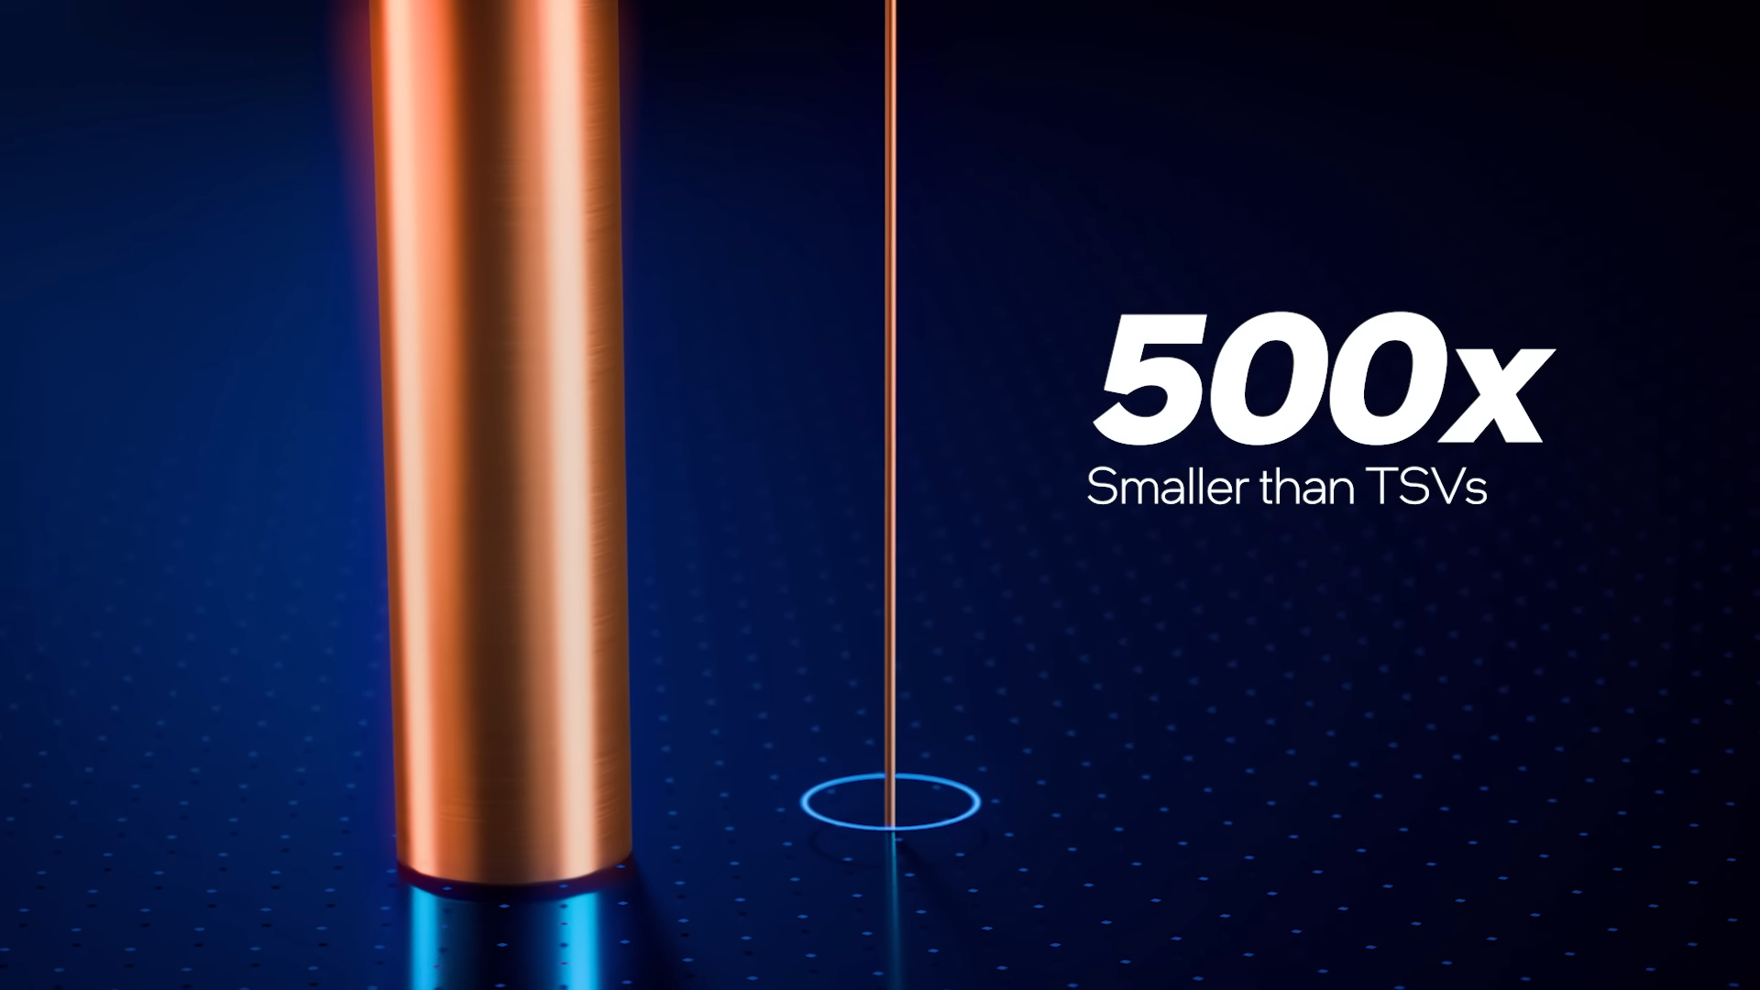

Slide 25
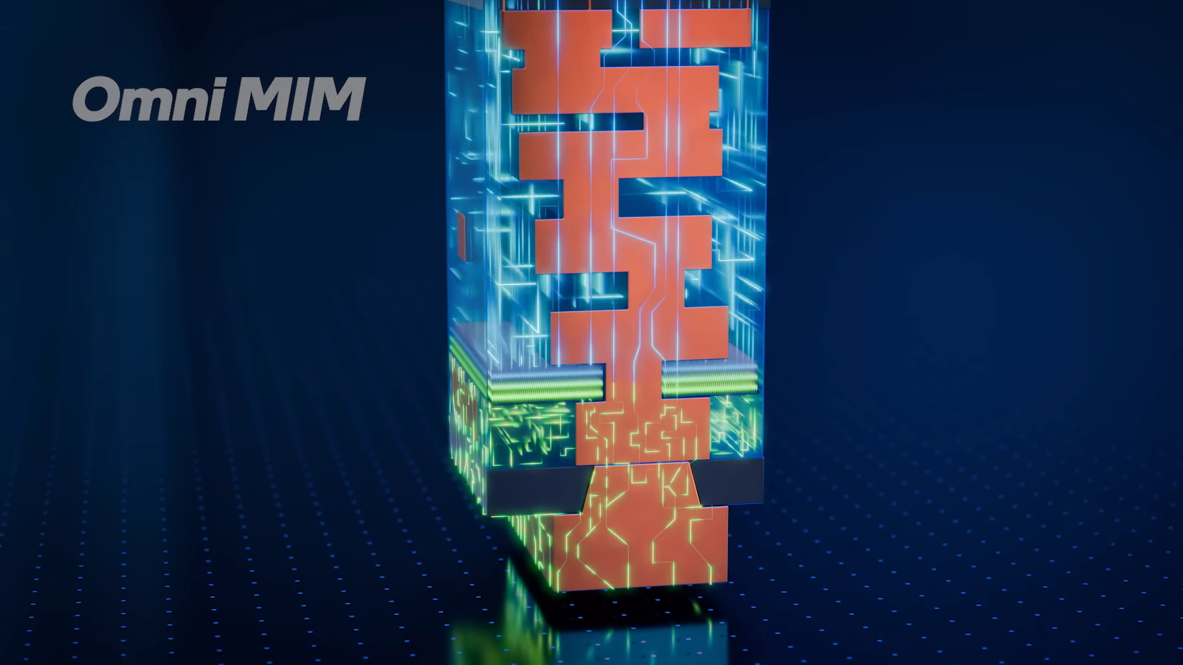

Slide 26
X3D by intel
Foveros 3D

Slide 27
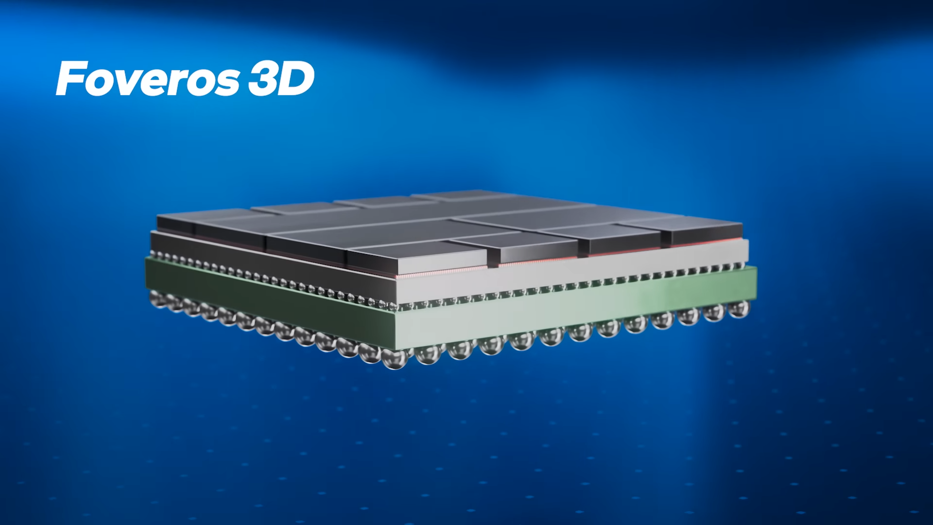

Slide 28
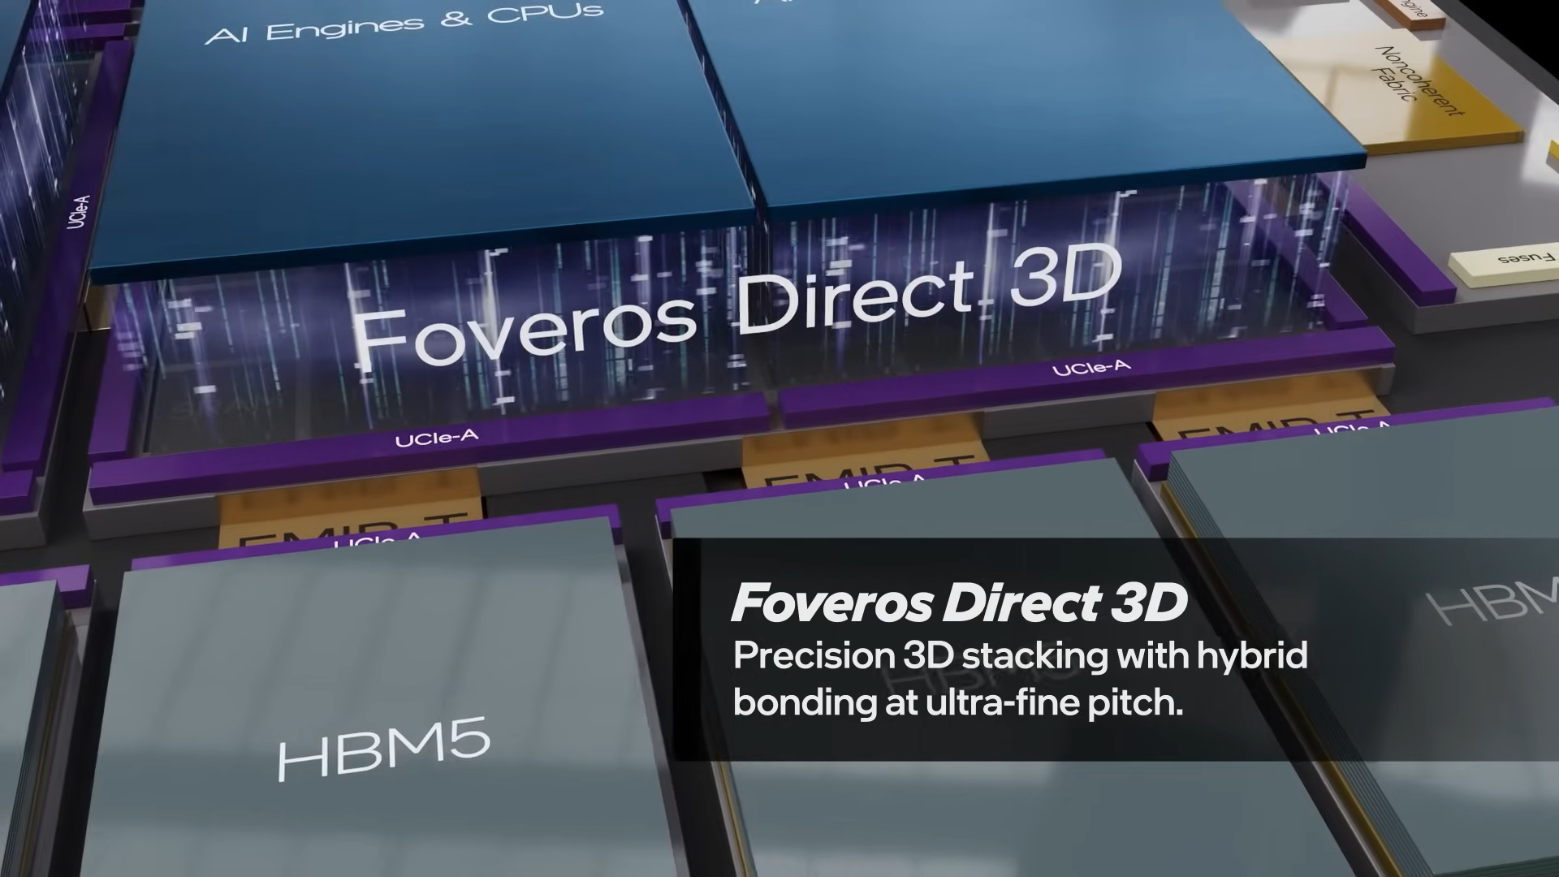

Slide 29
“面相企業級”

Slide 30


Slide 31
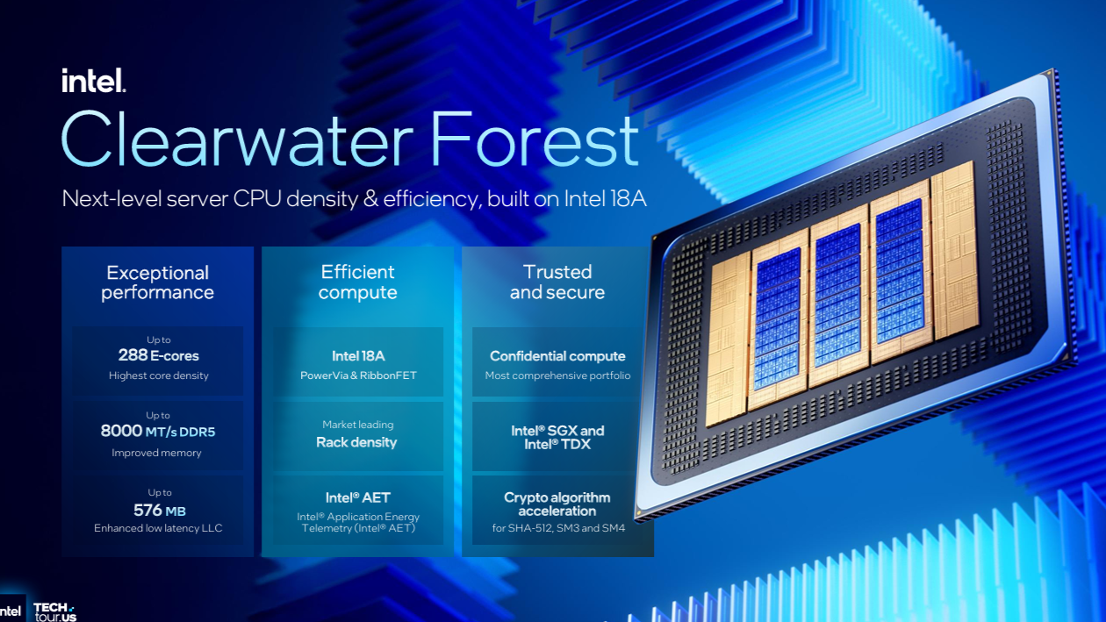

Slide 32
“面相消費級”

Slide 33
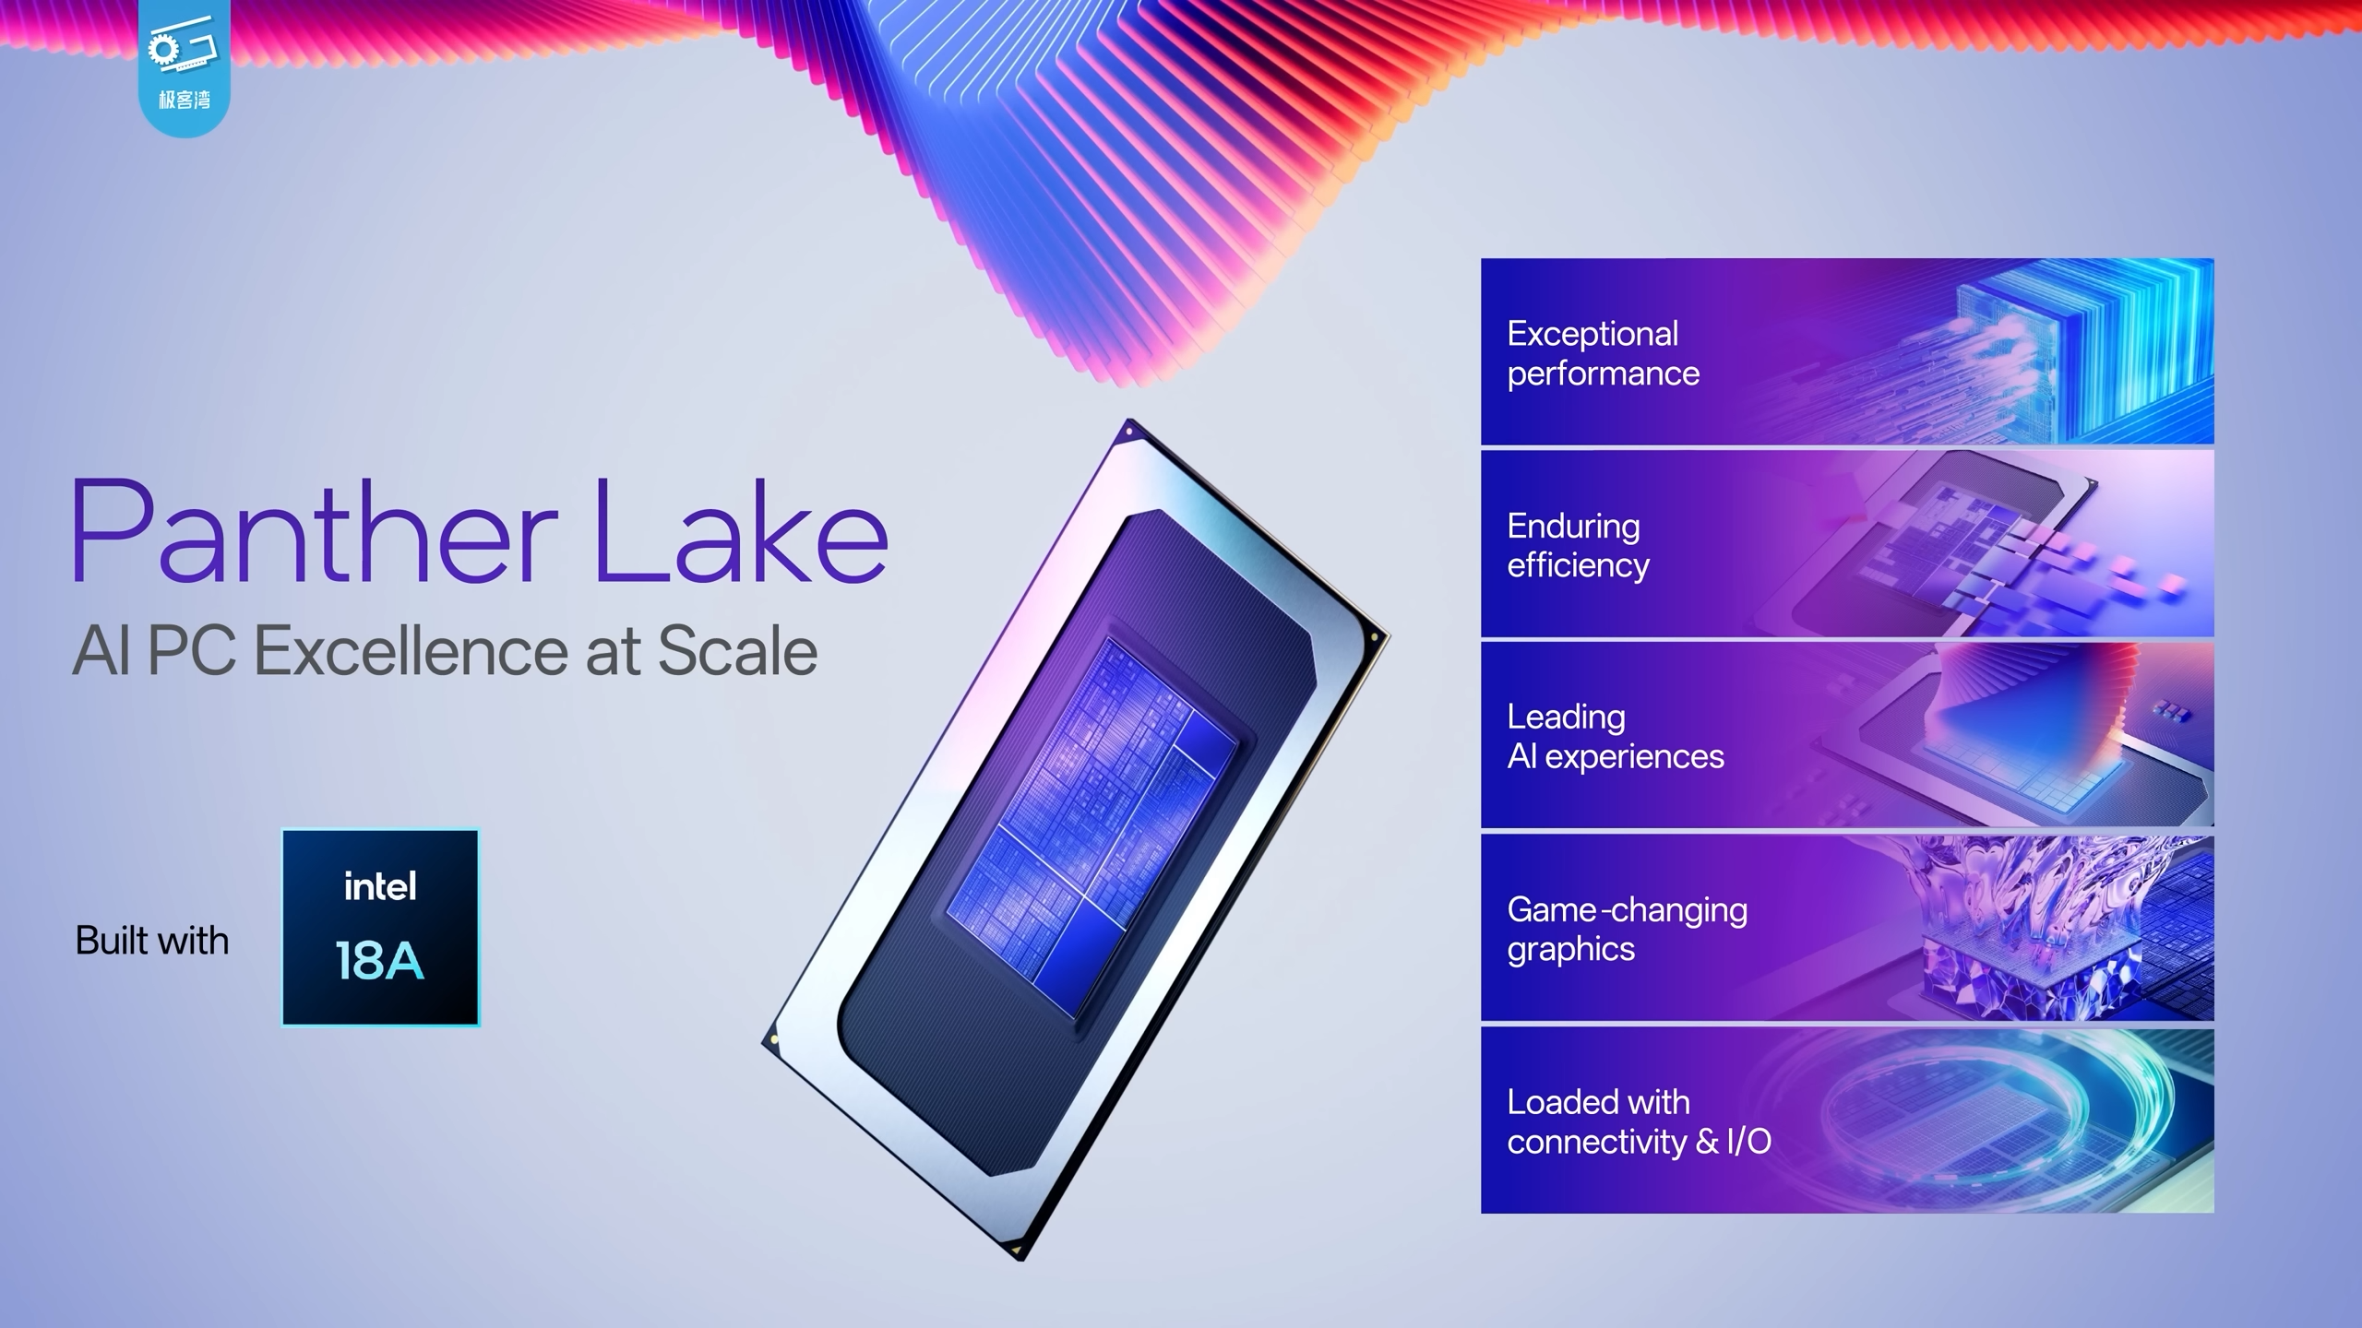

Slide 34
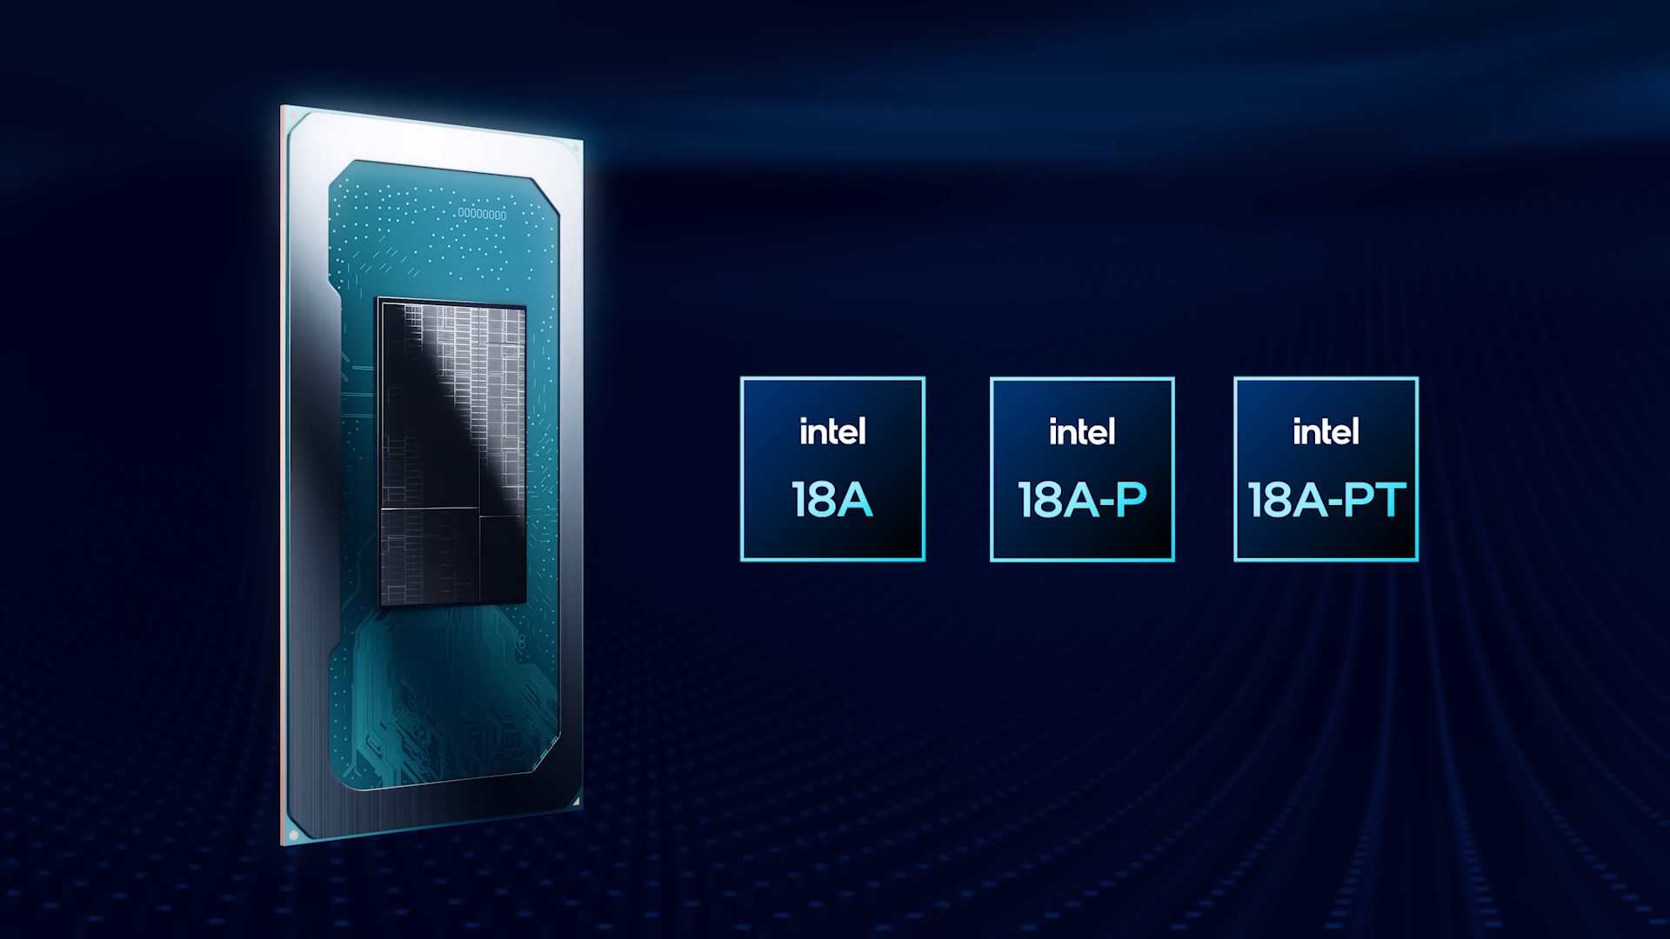

Slide 35
Refference
上手体验英特尔下一代芯片，还参观了晶圆厂！
By Geekerwan
Direct Connect 2025 | Front-End Technology Update with Ben Sell & Myung-Hee Na | Intel
By Intel foundry
Intel 18A overview
By Intel foundry
By Mobile01
Intel ITT 2025：以 RibbonFET 與 PowerVia 組合 18A 製程重回頂尖晶圓製造能力
Driving the Future of Multi-Chip Compute | Intel
By Intel foundry

Slide 36
“冷知識”

Slide 37
“P核快被E核幹掉了”

